Slide 1
SBEPC—Keeping IT Safe
MFA and Passwords
Kevin S. Klenk, PhD
26 October 2023

Slide 2
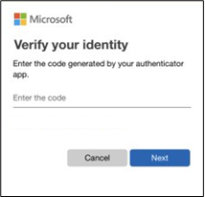
How does Multifactor Authentication (MFA) work?
Let's say you're going to sign into your work account, and you enter your username and password. If that's all you need then anybody who knows your username and password can sign in as you from anywhere in the world!
But if you have MFA enabled, the first time you sign in on a device or app you enter your username and password as usual, then you get prompted to enter your second factor to verify your identity.
The three most common kinds of factors are:
  Something you know—Like a password, or a memorized PIN.
  Something you have—Like a smartphone, or a Yubikey.
  Something you are—Like a fingerprint, or facial recognition.

Slide 3
MFA
Where to use
  Microsoft Windows (to login to your machine)
  Websites and apps: Practice Management system, Payroll system, Banking, etc.
Apps to use
  Microsoft Authenticator
  Authy
  1Password

Slide 4
Password Management Apps
You memorize a single password, and the app generates and keeps track of passwords for all your other sites and apps.
Each app and site has unique, randomly generated, long password.
You can share logins between team members without sharing the passwords themselves.
We like 1Password
  Available just about everywhere, including macOS, iOS, Android, Windows, Linux, and ChromeOS.

Slide 5
Thank You

